Slide 1


‘18.08.05 송석정
DL
Variational Autoencoders

Slide 2
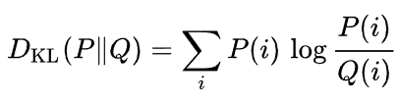
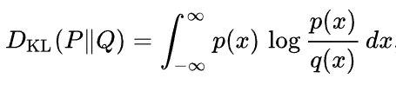
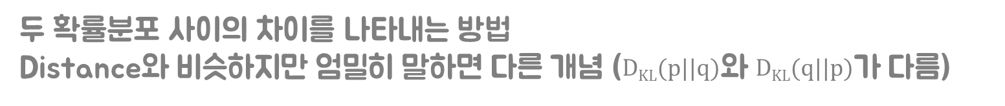
Kullback-Leibler Divergence
$두$ 확률분포 사이의 차이를 나타내는 방법
Distance와 비슷하지만 엄밀히 말하면 다른 개념 (D_{KL}(p||q)와 D_{KL}(q||p)가 다름)
For discrete probability distributions,
For continuous probability distributions,

Slide 3
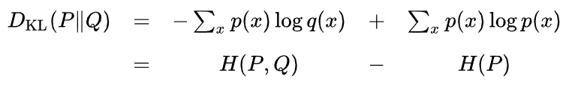
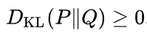
Kullback-Leibler Divergence
Motivation
H: entropy
KL divergence can be interpreted as the expected extra message-length per datum that must be communicated if a code that is optimal for a given (wrong) distribution Q is used, compared to using a code based on the true distribution P
Property
KL divergence is always non-negative
=0 if and only if P=Q

Slide 4
Generative Model
Discriminative model
Generative model

Slide 5
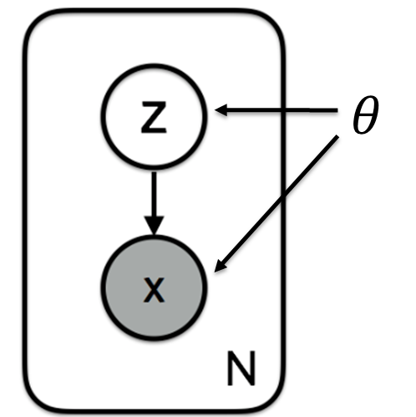
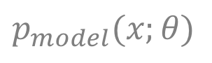
Generative model: Maximum Likelihood
데이터 𝒙가 주어졌을 때, 이를 잘 설명하는 parameter 𝜃 혹은 latent variable 𝓏 를 찾는 것이 목적.
$$p_{model}(x;θ)$$

Slide 6
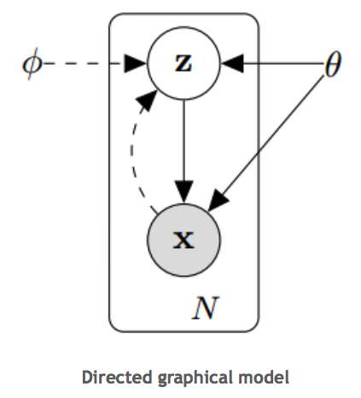

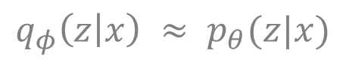
Generative model: Maximum Likelihood
We want to maximize $p_{θ}\left(z | x\right)$ w.r.t $θ$
Variational Inference: General family of methods for approximating complicated densities by a simpler lass of densities
$$q_{φ}\left(z | x\right) ≈ p_{θ}(z|x)$$

Slide 7
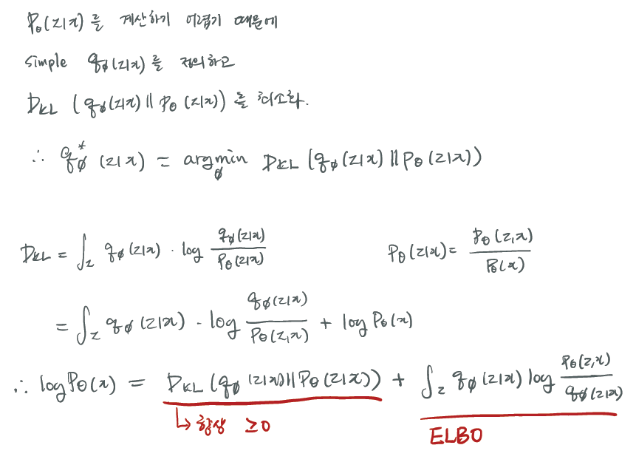
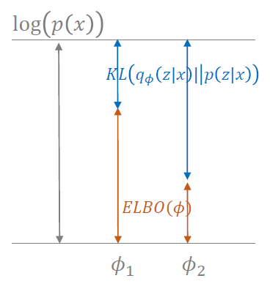
The Variational Bound

Slide 8
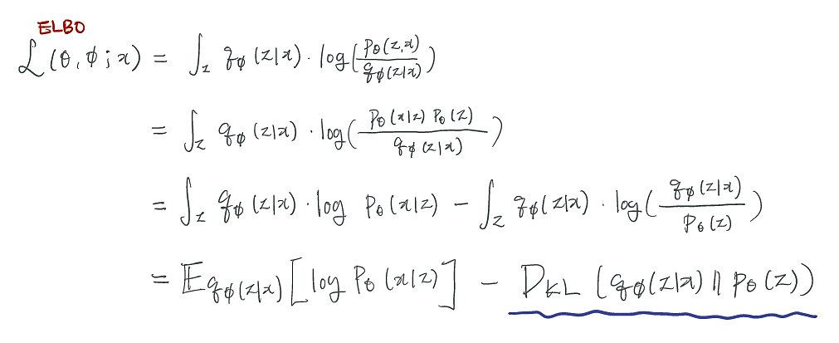
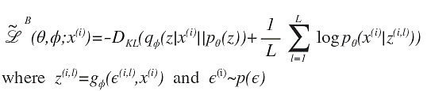
The Variational Bound
Stochastic Gradient Variational Bayes (SGVB)
L: number of samples

Slide 9
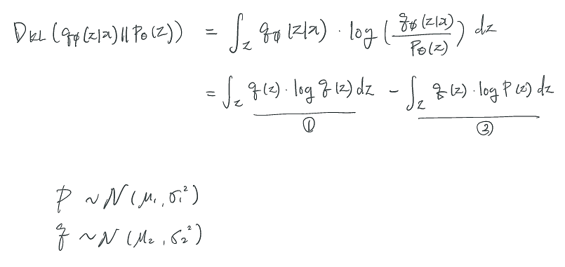
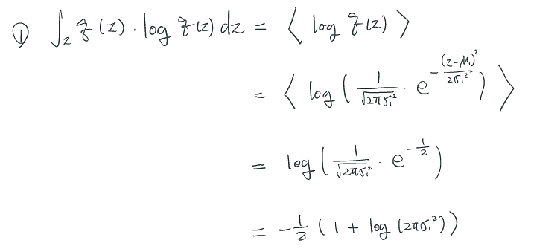
Analytic Solution of D_{KL}

Slide 10
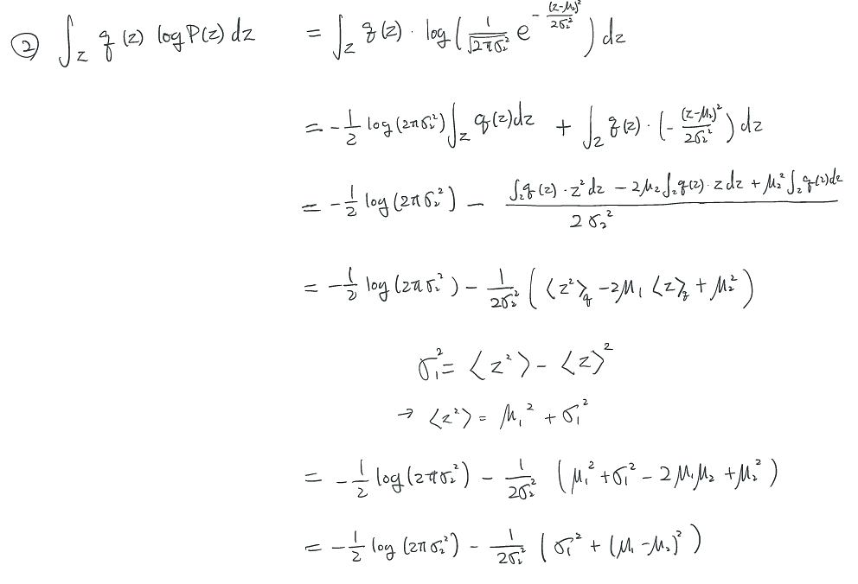
Analytic Solution of D_{KL}

Slide 11
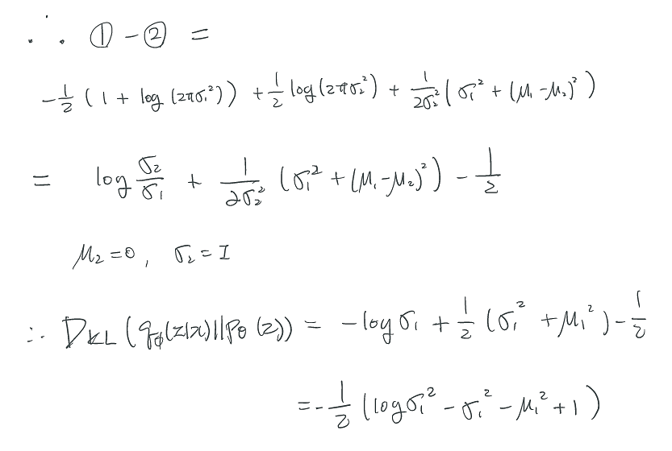
Analytic Solution of D_{KL}

Slide 12
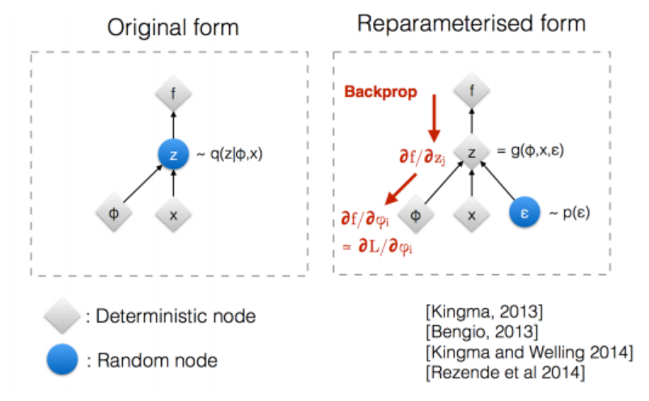
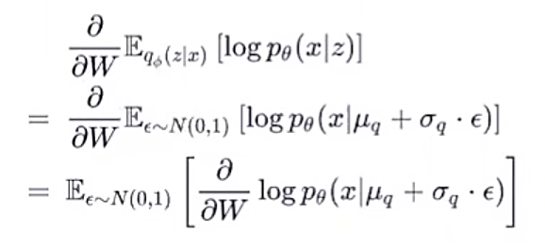
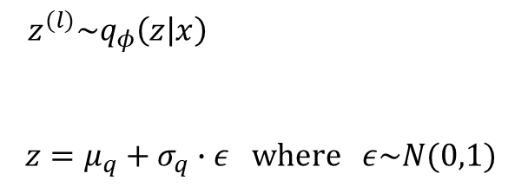
Reparameterization Trick
Alternative method for generating samples from $q_{φ}\left(z | x\right)$.
$$z^{(l)}\sim q_{φ}\left(z | x\right)$$
$$z=μ_{q}+σ_{q}∙ε \text{where} ε\sim N(0,1)$$

Slide 13
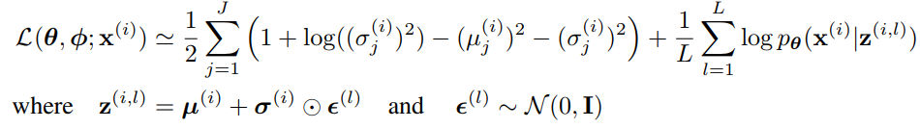
Final Objective Function

Slide 14
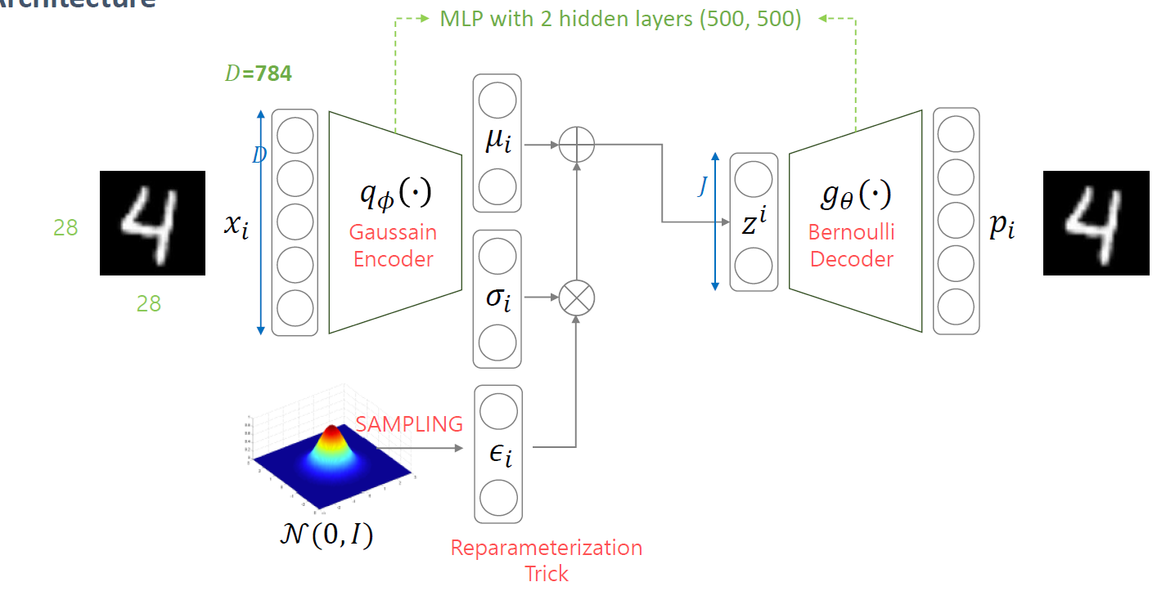
Variational Auto-Encoder
Architecture

Slide 15
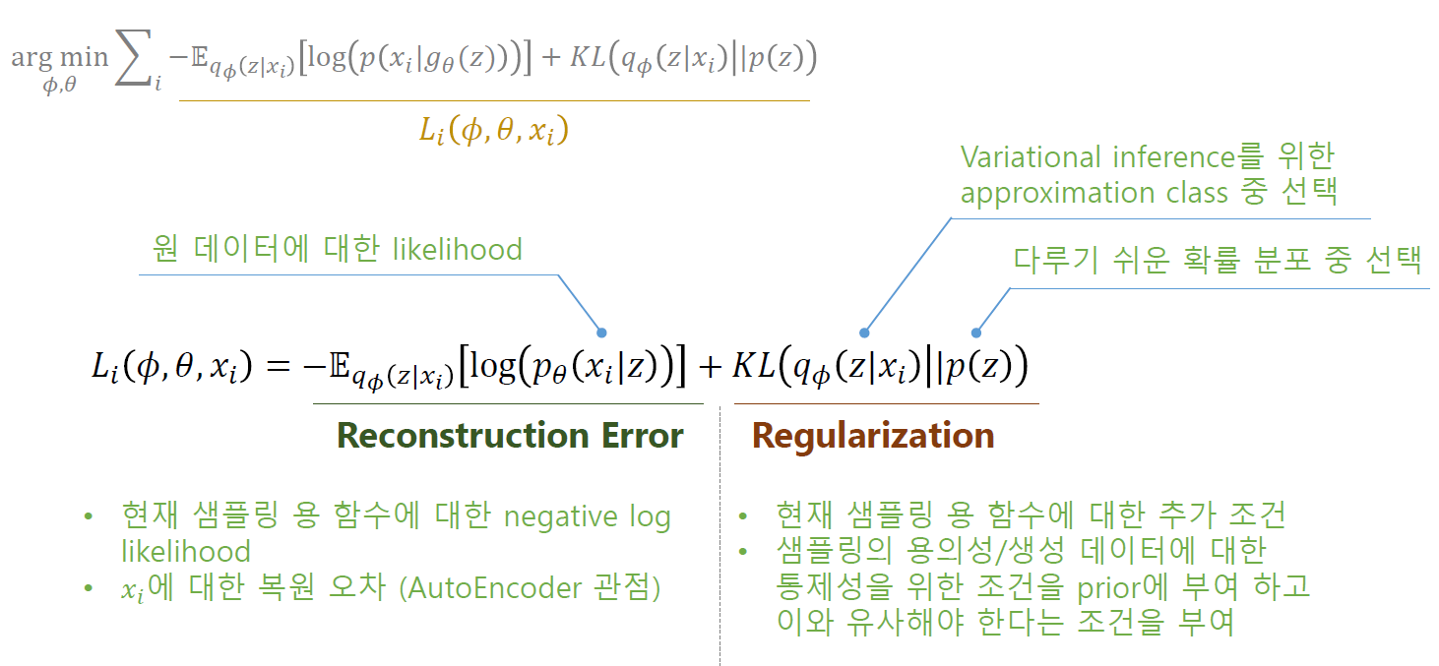
Variational Auto-Encoder
Loss function

Slide 16
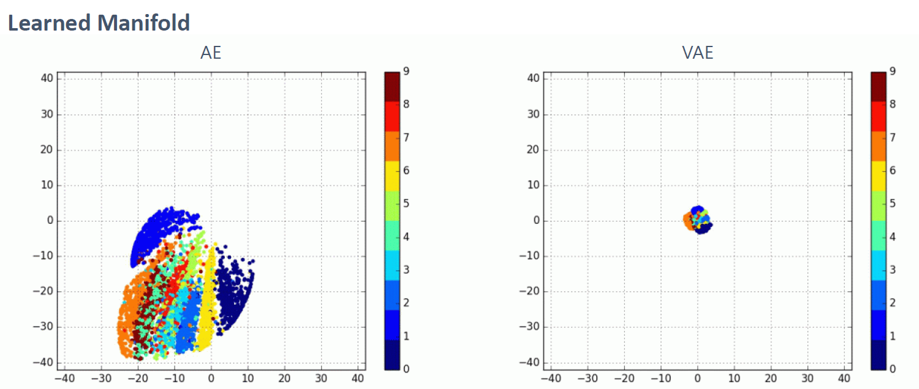
Variational Auto-Encoder
Results

Slide 17
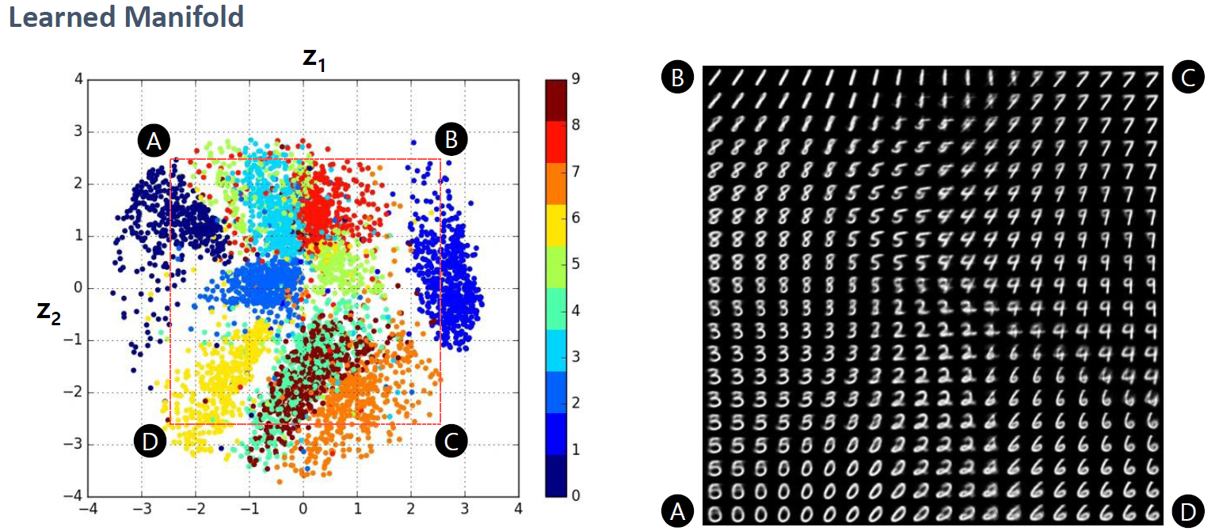
Variational Auto-Encoder
Results

Slide 18
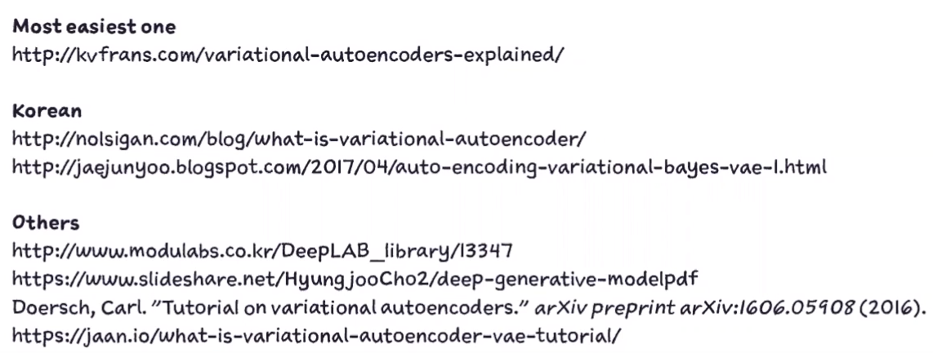
Manifold

Slide 19


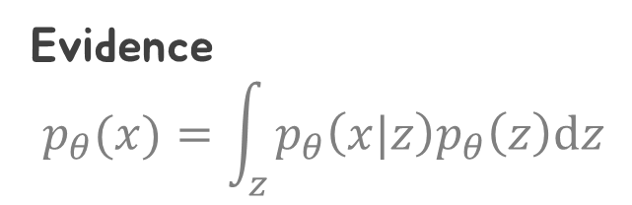
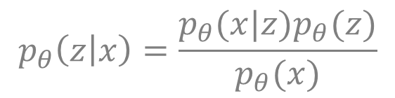
Generative model: Maximum Likelihood
We want to maximize $p_{θ}\left(z | x\right)$ w.r.t $θ$
$$p_{θ}\left(z | x\right)=\frac{p_{θ}(x|z)p_{θ}(z)}{p_{θ}(x)}$$
Evidence
$$p_{θ}(x)=\int_{z}^{ }{p_{θ}\left(x|z\right)p_{θ}\left(z\right)\text{d}z}$$
Variational Inference: General family of methods for approximating complicated densities by a simpler lass of densities
$$q_{φ}\left(z | x\right) ≈ p_{θ}(z|x)$$

Slide 20
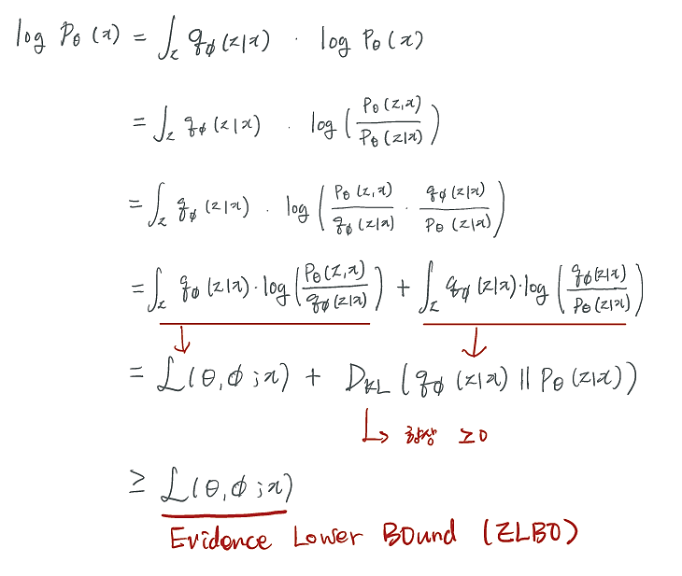
The Variational Bound

